Slide 1
Statistical Methods for Data Analysis a RooStats example
Luca Lista
INFN Napoli

Slide 2
RooStats toolkit
Concepts:
  PDF modeling: done via RooFit package
  Workspace: an area where the PDF and data model can be defined, and saved to disk for later use
  Interval Calculator: abstract class for computation of confidence intervals:
    Bayesian (plain, Markov Chain), central Neyman, Feldman-Cousins, …
  Hypothesis test calculator: abstract class to compute p-values, significance, CLs, …

Slide 3
Step-by-step example
Example presented during the last CMS Data Analysis School (FNAL-Pisa), by Gena Kukartsev
Create a ROOT macro, say counting.C, with a void function, say MakeWorkspace()
  #include directives and other details skipped for sake of simplicity; complete code available on request
Create workspace, save to disk
void MakeWorkspace( void ){
// create workspace
RooWorkspace * pWs = new RooWorkspace("myWS");
// save workspace to file
pWs->SaveAs("workspace.root”);
return;
}

Slide 4
Define parameters and PDF model
Create workspace
// create workspace
RooWorkspace * pWs = new RooWorkspace("myWS");
// observable: number of events
pWs->factory( "n[0]" );
// signal yield
pWs->factory( "nsig[0,0,100]" );
// NOTE: three parameters are "current value", "low bound", "upper bound”
// background yield
pWs->factory( "nbkg[10,0,100]" );
// full event yield
pWs->factory( "sum::yield(nsig,nbkg)" );
// NOTE: lower-case "sum" create a function. Upper-case "SUM" would create a PDF
// Core model: Poisson probability with mean signal+bkg
pWs->factory( "Poisson::model_core(n,yield)" );
// NOTE: "model_core" is a name of the PDF object
// print out the workspace contents
pWs->Print();
// save workspace to file
pWs->SaveAs("workspace.root”);

Slide 5
Output from ROOT
*******************************************
* *
* W E L C O M E to R O O T *
* *
* Version 5.32/00 2 December 2011 *
* *
* You are welcome to visit our Web site *
* http://root.cern.ch *
* *
*******************************************
ROOT 5.32/00 (tags/v5-32-00@42375, Dec 02 2011, 12:42:25 on linux)
CINT/ROOT C/C++ Interpreter version 5.18.00, July 2, 2010
Type ? for help. Commands must be C++ statements.
Enclose multiple statements between { }.
Loading rootlogon.C...
root [0] .L counting.C+
Info in : creating shared library /home/kukarzev/svn/exost/workdir/cmsdas2012/./counting_C.so
RooFit v3.50 -- Developed by Wouter Verkerke and David Kirkby
Copyright (C) 2000-2011 NIKHEF, University of California & Stanford University
All rights reserved, please read http://roofit.sourceforge.net/license.txt
root [1] MakeWorkspace()
RooWorkspace(myWS) myWS contents
variables
---------
(n,nbkg,nsig)
p.d.f.s
-------
RooPoisson::model_core[ x=n mean=yield ] = 4.53999e-05
functions
--------
RooAddition::yield[ nsig + nbkg ] = 10

Slide 6
Replace nsig by σ×ε×L
// signal yield
// pWs->factory( "nsig[0,0,100]" );
// integrated luminosity
pWs->factory( "lumi[0]" );
// cross section - parameter of interest
pWs->factory( "xsec[0,0,0.1]" );
// selection efficiency * acceptance
pWs->factory( "efficiency[0]" );
// signal yield
pWs->factory( "prod::nsig(lumi,xsec,efficiency)" );
Define prior PDF (uniform)
// define Bayesian prior PDF for POI
pWs->factory( "Uniform::prior(xsec)" );

Slide 7
Systematic uncertainty: lumi
Log-normal uncertainty assumed for luminosity uncertainty:
  L = L_{nom} α_{lumi}
  Where α_{lumi} = κ^{βlumi}, where β_{lumi} is the new nuisance parameter distributed normally
  κ = 1.045 equivalent to 4.5% uncertainty on L_{nom}.
// integrated luminosity
// pWs->factory( "lumi[0]" );
// integrated luminosity with systematics
pWs->factory( "lumi_nom[5000.0, 4000.0, 6000.0]" );
pWs->factory( "lumi_kappa[1.045]" );
pWs->factory( "cexpr::alpha_lumi('pow
(lumi_kappa,beta_lumi)',lumi_kappa,beta_lumi[0,-5,5])" );
pWs->factory( "prod::lumi(lumi_nom,alpha_lumi)" );
pWs->factory( "Gaussian::constr_lumi(beta_lumi,glob_lumi[0,-5,5],1)" );

Slide 8
Lumi uncertainty (cont.)
Build the PDF model from a “core” model
Luminosity also affects background normalization:
  n^{bkg} = n^{bkg}_{nom} α_{lumi}
// Core model: Poisson probability with mean signal+bkg
pWs->factory( "Poisson::model_core(n,yield)" );
...
// model with systematics
pWs->factory( "PROD::model(model_core,constr_lumi)" );
// background yield
// pWs->factory( "nbkg[10,0,100]" );
// background yield
pWs->factory( "nbkg_nom[10]" );
pWs->factory( "prod::nbkg(nbkg_nom,alpha_lumi)" );

Slide 9
Systematic uncertainty: efficiency
Proceed similarly for efficiency (10% uncertainty)
// selection efficiency * acceptance
// pWs->factory( "efficiency[0]" );
// selection efficiency * acceptance with systematics
pWs->factory( "efficiency_nom[0.1, 0.05, 0.15]" );
pWs->factory( "efficiency_kappa[1.10]" );
pWs->factory( "cexpr::alpha_efficiency('pow
(efficiency_kappa,beta_efficiency)',
efficiency_kappa,beta_efficiency[0,-5,5])" );
pWs->factory( "prod::efficiency(efficiency_nom,alpha_efficiency)" );
pWs->factory( "Gaussian::constr_efficiency
(beta_efficiency,glob_efficiency[0,-5,5],1)" );
// model with systematics
// pWs->factory( "PROD::model(model_core,constr_lumi)" );
// model with systematics
pWs->factory( "PROD::model(model_core,constr_lumi,constr_efficiency)" );

Slide 10
Systematic uncertainty: n_{bkg}
Proceed similarly for n_{bkg} (10% uncertainty)
// background yield
// pWs->factory( "nbkg_nom[10]" );
// background yield with systematics
pWs->factory( "nbkg_nom[10.0, 5.0, 15.0]" );
pWs->factory( "nbkg_kappa[1.10]" );
pWs->factory( "cexpr::alpha_nbkg('pow
(nbkg_kappa,beta_nbkg)',nbkg_kappa,beta_nbkg[0,-5,5])" );
pWs->factory( "prod::nbkg(nbkg_nom,alpha_lumi,alpha_nbkg)" );
pWs->factory( "Gaussian::constr_nbkg(beta_nbkg,glob_nbkg[0,-5,5],1)" );
// model with systematics
// pWs->factory( "PROD::model(model_core,constr_lumi,constr_efficiency)" );
// model with systematics
pWs->factory( "PROD::model
(model_core,constr_lumi,constr_efficiency,constr_nbkg)" );

Slide 11
Define dataset
Use RooFit data set as data container
// create set of observables (will need it for datasets and ModelConfig later)
RooRealVar * pObs = pWs->var("n"); // get the pointer to the observable
RooArgSet obs("observables");
obs.add(*pObs);
// create the dataset
pObs->setVal(11); // this is your observed data: you counted eleven events
RooDataSet * data = new RooDataSet("data", "data", obs);
data->add( *pObs );
// import dataset into workspace
pWs->import(*data);

Slide 12
Model configuration
// create set of global observables (need to be defined as constants!)
pWs->var("glob_lumi")->setConstant(true);
pWs->var("glob_efficiency")->setConstant(true);
pWs->var("glob_nbkg")->setConstant(true);
RooArgSet globalObs("global_obs");
globalObs.add( *pWs->var("glob_lumi") );
globalObs.add( *pWs->var("glob_efficiency") );
globalObs.add( *pWs->var("glob_nbkg") );
// create set of parameters of interest (POI)
RooArgSet poi("poi");
poi.add( *pWs->var("xsec") );
// create set of nuisance parameters
RooArgSet nuis("nuis");
nuis.add( *pWs->var("beta_lumi") );
nuis.add( *pWs->var("beta_efficiency") );
nuis.add( *pWs->var("beta_nbkg") );
// fix all other variables in model:
// everything except observables, POI, and nuisance parameters
// must be constant
pWs->var("lumi_nom")->setConstant(true);
pWs->var("efficiency_nom")->setConstant(true);
pWs->var("nbkg_nom")->setConstant(true);
pWs->var("lumi_kappa")->setConstant(true);
pWs->var("efficiency_kappa")->setConstant(true);
pWs->var("nbkg_kappa")->setConstant(true);
RooArgSet fixed("fixed");
fixed.add( *pWs->var("lumi_nom") );
fixed.add( *pWs->var("efficiency_nom") );
fixed.add( *pWs->var("nbkg_nom") );
fixed.add( *pWs->var("lumi_kappa") );
fixed.add( *pWs->var("efficiency_kappa") );
fixed.add( *pWs->var("nbkg_kappa") );
// create signal+background Model Config
RooStats::ModelConfig sbHypo("SbHypo");
sbHypo.SetWorkspace( *pWs );
sbHypo.SetPdf( *pWs->pdf("model") );
sbHypo.SetObservables( obs );
sbHypo.SetGlobalObservables( globalObs );
sbHypo.SetParametersOfInterest( poi );
sbHypo.SetNuisanceParameters( nuis );
// this is optional, for Bayesian analysis
sbHypo.SetPriorPdf( *pWs->pdf("prior") );
// import ModelConfig into workspace
pWs->import( sbHypo );

Slide 13
Parameter snapshot
A parameter snapshot consists of saved values of a subset of model parameters, which can be loaded at any time.
A useful snapshot corresponds to the values of the POI and nuisance parameters, which correspond to the best fit to the experimental data
// set parameter snapshot that corresponds to the best fit to data
RooAbsReal * pNll = sbHypo.GetPdf()->createNLL( *data );
// do not profile global observables
RooAbsReal * pProfile = pNll->createProfile( globalObs );
// this will do fit and set POI and nuisance
pProfile->getVal(); parameters to fitted values
RooArgSet * pPoiAndNuisance = new RooArgSet("poiAndNuisance");
pPoiAndNuisance->add(*sbHypo.GetNuisanceParameters());
pPoiAndNuisance->add(*sbHypo.GetParametersOfInterest());
sbHypo.SetSnapshot(*pPoiAndNuisance);
delete pProfile;
delete pNll;
delete pPoiAndNuisance;
// import S+B ModelConfig into workspace
pWs->import( sbHypo );

Slide 14
Adding more hypotheses models
More than one ModelConfig can be added to the workspace for later use
// create background-only Model Config from the S+B one
RooStats::ModelConfig bHypo = sbHypo;
bHypo.SetName("BHypo");
bHypo.SetWorkspace(*pWs);
// set parameter snapshot for bHypo, setting xsec=0
// it is useful to understand how this block of code works
// but you can also use it as a recipe to make a parameter snapshot
pNll = bHypo.GetPdf()->createNLL( *data );
RooArgSet poiAndGlobalObs("poiAndGlobalObs");
poiAndGlobalObs.add( poi );
poiAndGlobalObs.add( globalObs );
// do not profile POI and global observables
pProfile = pNll->createProfile( poiAndGlobalObs );
((RooRealVar *)poi.first())->setVal( 0 ); // set xsec=0 here
pProfile->getVal(); // this will do fit and set nuisance parameters to profiled values
pPoiAndNuisance = new RooArgSet( "poiAndNuisance" );
pPoiAndNuisance->add( nuis );
pPoiAndNuisance->add( poi );
bHypo.SetSnapshot(*pPoiAndNuisance);
delete pProfile;
delete pNll;
delete pPoiAndNuisance;
// import model config into workspace
bHypo.SetWorkspace(*pWs);
pWs->import( bHypo );

Slide 15
Using the a workspace
Create a new ROOT macro, say bayesian_num.C, with a void function, say GetBayesianInterval ()
  #include directives and other details again skipped
int GetBayesianInterval( std::string filename = "workspace.root”,
std::string wsname = "myWS" ){
// open file with workspace for reading
TFile * pInFile = new TFile(filename.c_str(), "read");
// load workspace
RooWorkspace * pWs = (RooWorkspace *)pInFile->Get(wsname.c_str());
if (!pWs){
std::cout << "workspace " << wsname << " not found" << std::endl;
return -1;
}
// printout workspace content
pWs->Print();
// load and print data from workspace
RooAbsData * data = pWs->data("data");
data->Print();
// load and print S+B Model Config
RooStats::ModelConfig * pSbHypo = (RooStats::ModelConfig *)pWs->obj("SbHypo");
pSbHypo->Print();
return 0;
}

Slide 16
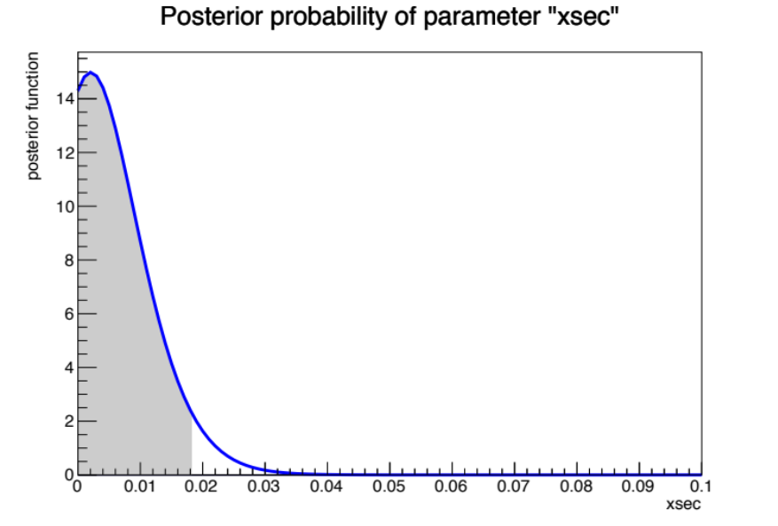
Compute limits (Bayesian)
// create RooStats Bayesian calculator and set parameters
RooStats::BayesianCalculator bCalc(*data, *pSbHypo);
bCalc.SetName("myBC");
bCalc.SetConfidenceLevel(0.95);
bCalc.SetLeftSideTailFraction(0.0);
// bCalc->SetIntegrationType("ROOFIT");
// estimate credible interval
// NOTE: unfortunate notation: the UpperLimit() name refers
// to the upper boundary of an interval,
// NOT to the upper limit on the parameter of interest
// (it just happens to be the same for the one-sided
// interval starting at 0)
RooStats::SimpleInterval * pSInt = bCalc.GetInterval();
double upper_bound = pSInt->UpperLimit();
double lower_bound = pSInt->LowerLimit();
std::cout << "one-sided 95%.C.L. bayesian "
"credible interval for xsec: ["
<< lower_bound << ", " << upper_bound
<< "]" << std::endl;
// make posterior PDF plot for POI
TCanvas c1("posterior");
bCalc.SetScanOfPosterior(100);
RooPlot * pPlot = bCalc.GetPosteriorPlot();
pPlot->Draw();
c1.SaveAs("bayesian_num_posterior.pdf");
// clean up a little
delete pSInt;

Slide 17
Bayesian Markov Chain
Copy bayesian_num.C to bayesian_mcmc.C and insert the code below
// Metropolis-Hastings algorithm needs a proposal function
RooStats::SequentialProposal sp(10.0);
RooStats::MCMCCalculator mcmc( *data, *pSbHypo );
mcmc.SetConfidenceLevel(0.95);
mcmc.SetNumIters(100000); //num. iterations
mcmc.SetProposalFunction(sp);
//first N steps to be ignored as burn-in
mcmc.SetNumBurnInSteps(500);
mcmc.SetLeftSideTailFraction(0.0);
//binning for plotting only
mcmc.SetNumBins(40);
// estimate credible interval
RooStats::MCMCInterval * pMcmcInt = mcmc.GetInterval();
double upper_bound =
pMcmcInt->UpperLimit( *pWs->var("xsec") );
double lower_bound =
pMcmcInt->LowerLimit( *pWs->var("xsec") );
std::cout << "one-sided 95%.C.L. bayesian "
" credible interval for xsec: ["
<< lower_bound << ", " << upper_bound << "]"
<< std::endl;
// make posterior PDF plot for POI
TCanvas c1("posterior");
RooStats::MCMCIntervalPlot plot(*pMcmcInt);
plot.Draw();
c1.SaveAs("bayesian_mcmc_posterior.pdf");
// make scatter plots to visualise the Marov chain
TCanvas c2("xsec_vs_beta_lumi");
plot.DrawChainScatter( *pWs->var("xsec"),
*pWs->var("beta_lumi"));
c2.SaveAs("scatter_mcmc_xsec_vs_beta_lumi.pdf");
TCanvas c3("xsec_vs_beta_efficiency");
plot.DrawChainScatter( *pWs->var("xsec"),
*pWs->var("beta_efficiency"));
c3.SaveAs("scatter_xsec_vs_beta_efficiency.pdf");
TCanvas c4("xsec_vs_beta_nbkg");
plot.DrawChainScatter( *pWs->var("xsec"),
*pWs->var("beta_nbkg"));
c4.SaveAs("scatter_xsec_vs_beta_nbkg.pdf");
// clean up a little
delete pMcmcInt;

Slide 18
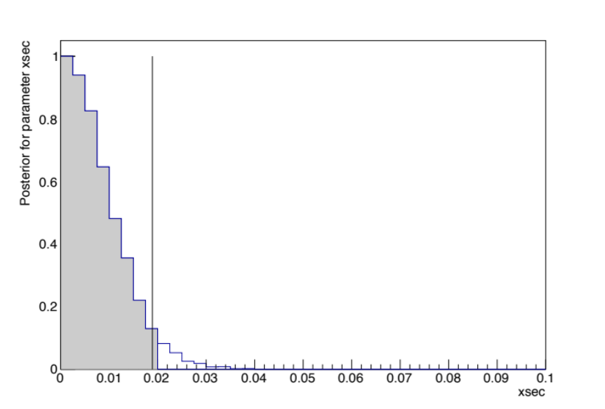
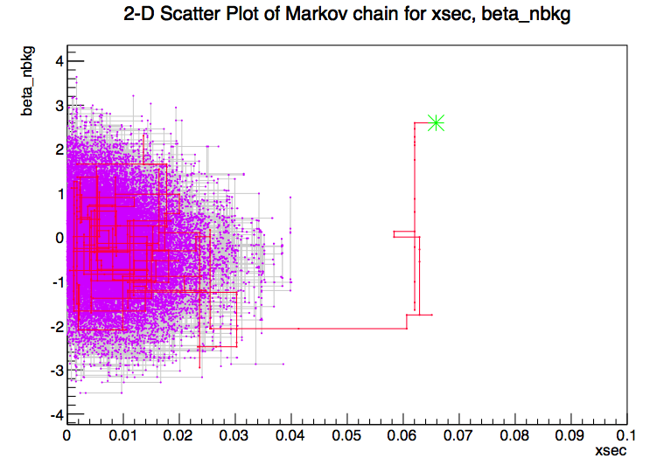
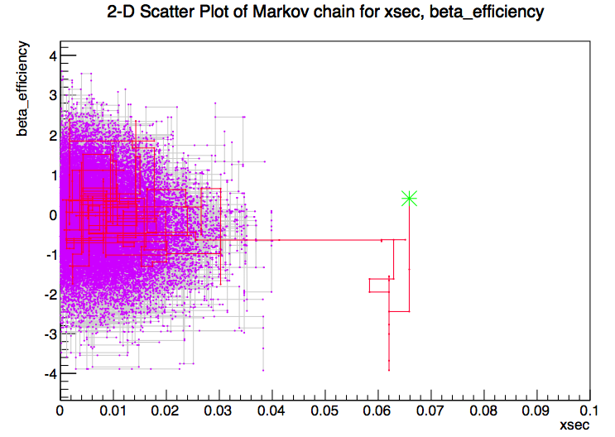
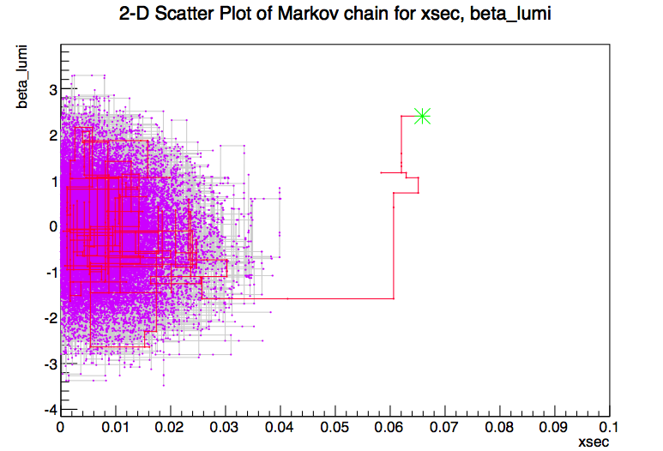
Bayesian MCMC plots

